Slide 1
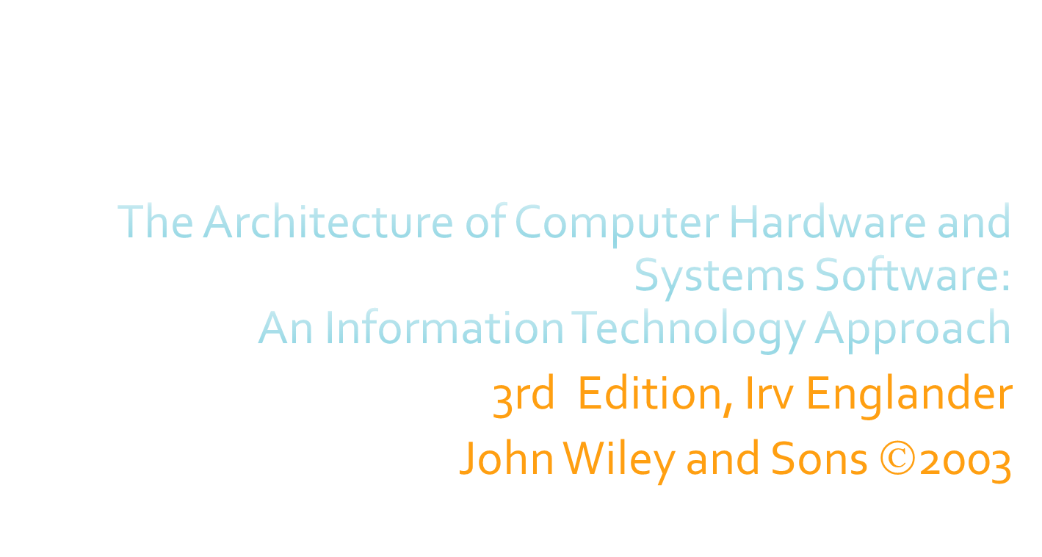
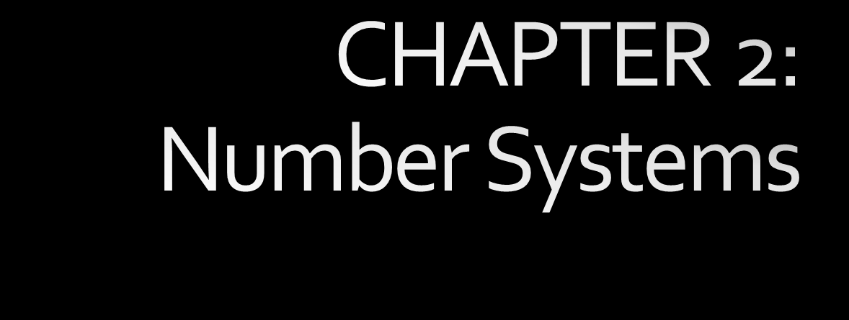

Slide 2

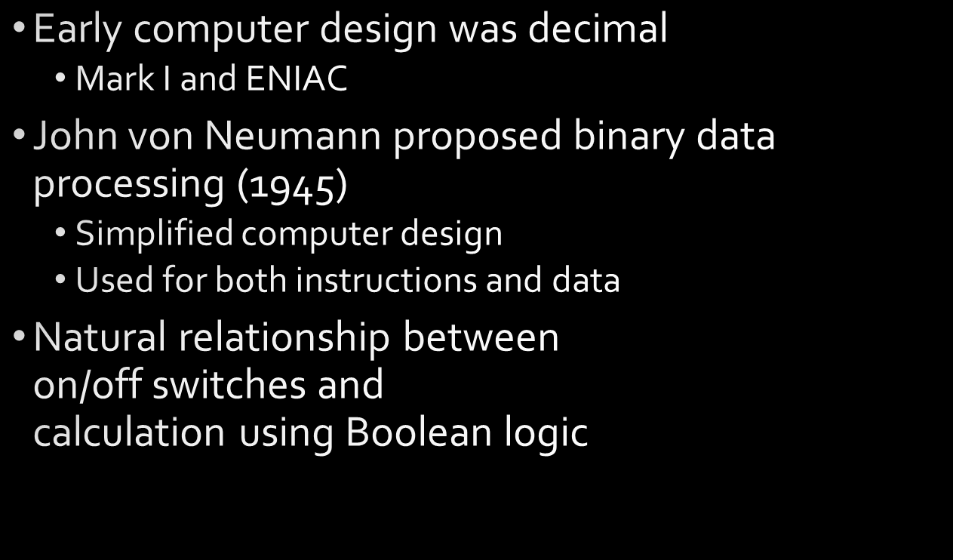


On | Off
True | False
Yes | No
1 | 0
Chapter 2 Number Systems
2-<number>

Slide 3

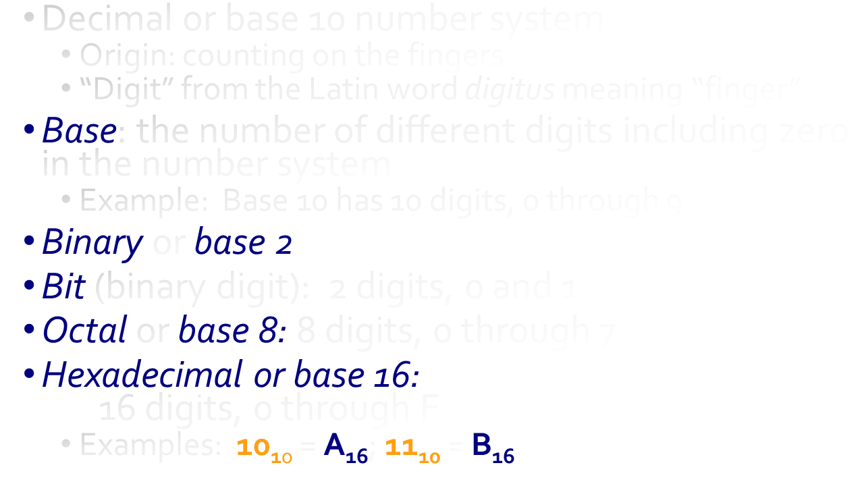
Chapter 2 Number Systems
2-<number>

Slide 4

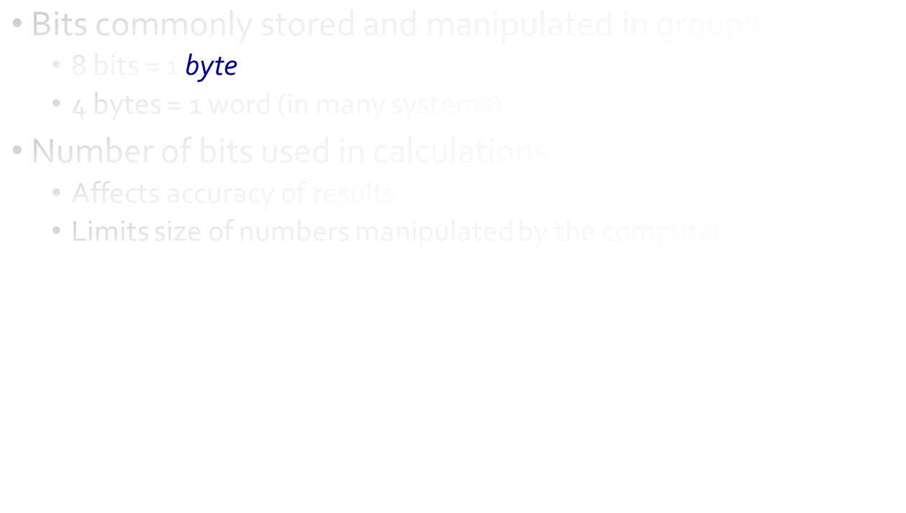
Chapter 2 Number Systems
2-<number>

Slide 5
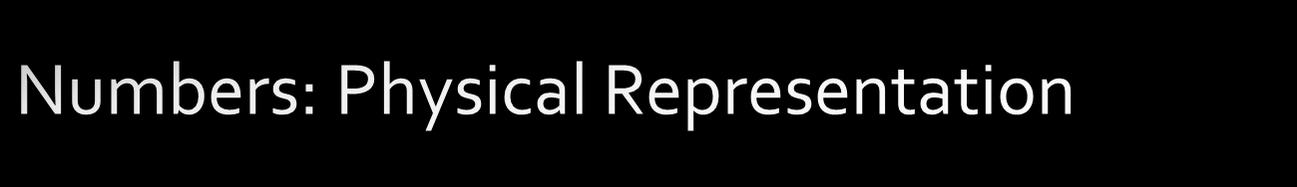
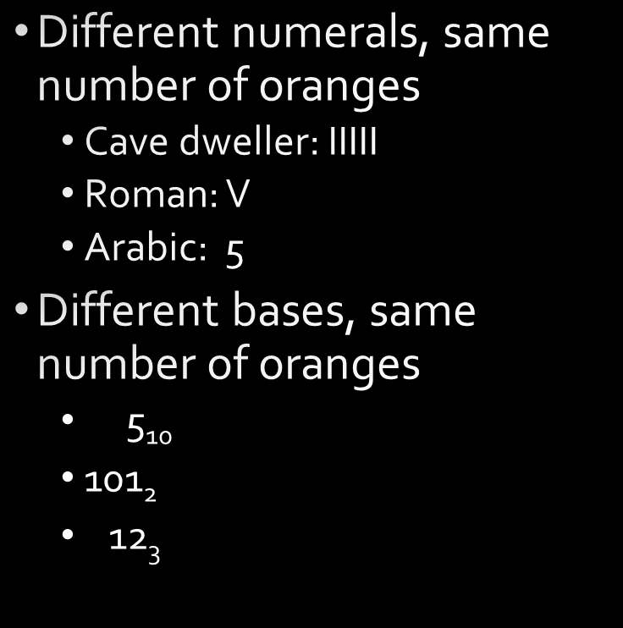
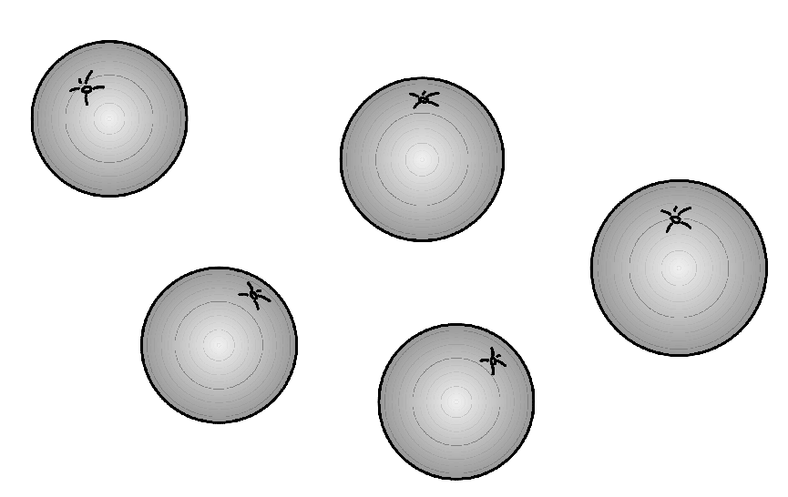
Chapter 2 Number Systems
2-<number>

Slide 6
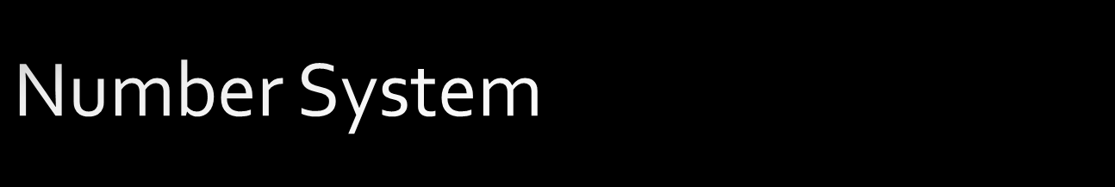
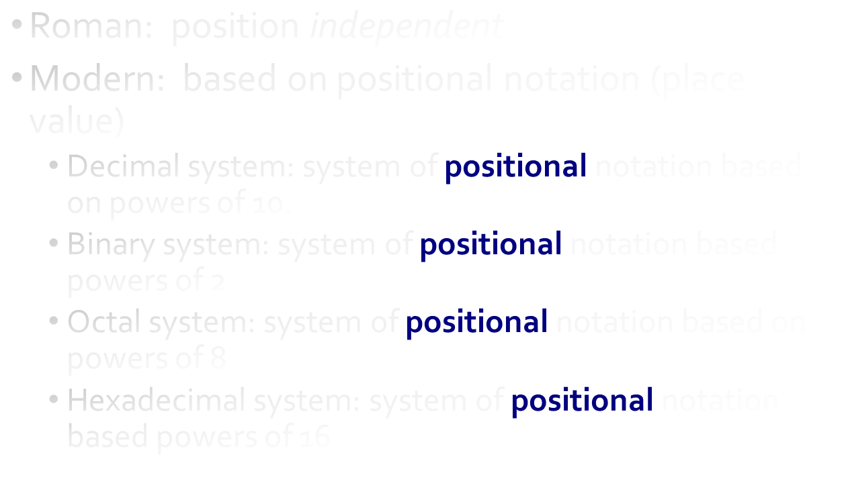
Chapter 2 Number Systems
2-<number>

Slide 7

43 = 4 x 10¹ + 3 x 10⁰
10’s place
1’s place
Place | 10¹ | 10⁰
Value | 10 | 1
Evaluate | 4 x 10 | 3 x1
Sum | 40 | 3
Chapter 2 Number Systems
2-<number>

Slide 8
527 = 5 x 10² + 2 x 10¹ + 7 x 10⁰
100’s place
10’s place
1’s place
Place | 10² | 10¹ | 10⁰
Value | 100 | 10 | 1
Evaluate | 5 x 100 | 2 x 10 | 7 x1
Sum | 500 | 20 | 7
Chapter 2 Number Systems
2-<number>

Slide 9

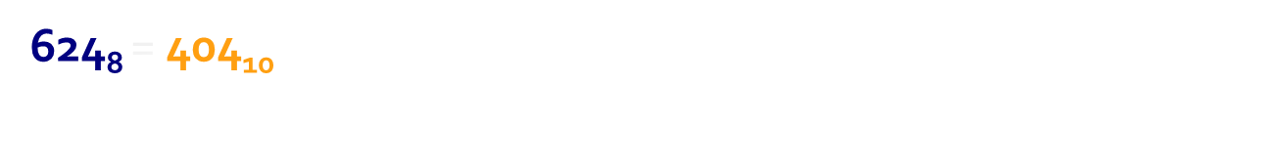
64’s place
8’s place
1’s place
Place | 8² | 8¹ | 8⁰
Value | 64 | 8 | 1
Evaluate | 6 x 64 | 2 x 8 | 4 x 1
Sum for Base 10 | 384 | 16 | 4
Chapter 2 Number Systems
2-<number>

Slide 10
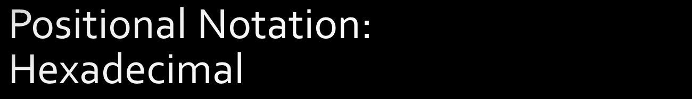
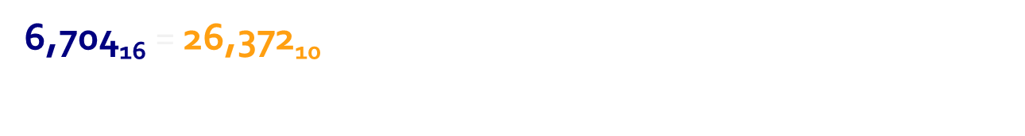
4,096’s place
256’s place
16’s place
1’s place
Place | 16³ | 16² | 16¹ | 16⁰
Value | 4,096 | 256 | 16 | 1
Evaluate | 6 x 4,096 | 7 x 256 | 0 x 16 | 4 x 1
Sum for Base 10 | 24,576 | 1,792 | 0 | 4
Chapter 2 Number Systems
2-<number>

Slide 11

1101 0110₂ = 214₁₀
Place | 2⁷ | 2⁶ | 2⁵ | 2⁴ | 2³ | 2² | 2¹ | 2⁰
Value | 128 | 64 | 32 | 16 | 8 | 4 | 2 | 1
Evaluate | 1 x 128 | 1 x 64 | 0 x 32 | 1 x16 | 0 x 8 | 1 x 4 | 1 x 2 | 0 x 1
Sum for Base 10 | 128 | 64 | 0 | 16 | 0 | 4 | 2 | 0
Chapter 2 Number Systems
2-<number>

Slide 12
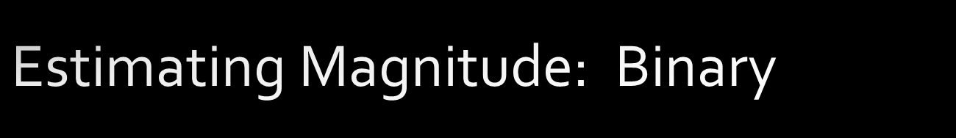
1101 011₀₂ = 214₁₀
1101 011₀₂ > 192₁₀ (128 + 64 + additional bits to the right)
Place | 2⁷ | 2⁶ | 2⁵ | 2⁴ | 2³ | 2² | 2¹ | 2⁰
Value | 128 | 64 | 32 | 16 | 8 | 4 | 2 | 1
Evaluate | 1 x 128 | 1 x 64 | 0 x 32 | 1 x16 | 0 x 8 | 1 x 4 | 1 x 2 | 0 x 1
Sum for Base 10 | 128 | 64 | 0 | 16 | 0 | 4 | 2 | 0
Chapter 2 Number Systems
2-<number>

Slide 13

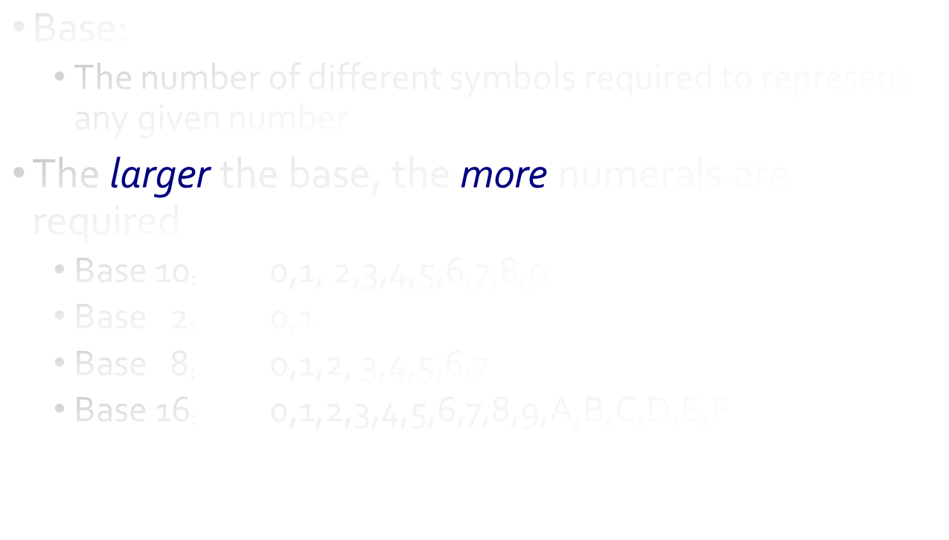
Chapter 2 Number Systems
2-<number>

Slide 14
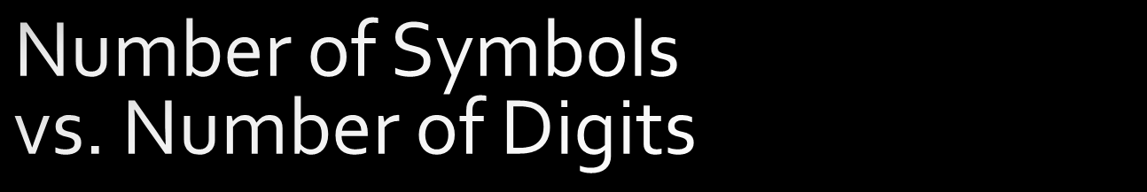
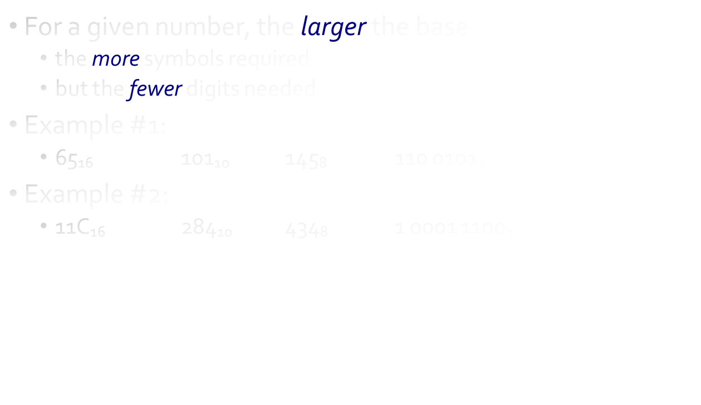
Chapter 2 Number Systems
2-<number>

Slide 15

Binary Number | Equivalent |  |  |  | Decimal Number
 | 8’s (2³) | 4’s (2²) | 2’s (2¹) | 1’s (2⁰)
0 |  |  |  | 0 x 2⁰ | 0
1 |  |  |  | 1 x 2⁰ | 1
10 |  |  | 1 x 2¹ | 0 x 2⁰ | 2
11 |  |  | 1 x 2¹ | 1 x 2⁰ | 3
100 |  | 1 x 2² |  |  | 4
101 |  | 1 x 2² |  | 1 x 2⁰ | 5
110 |  | 1 x 2² | 1 x 2¹ |  | 6
111 |  | 1 x 2² | 1 x 2¹ | 1 x 2⁰ | 7
1000 | 1 x 2³ |  |  |  | 8
1001 | 1 x 2³ |  |  | 1 x 2⁰ | 9
1010 | 1 x 2³ |  | 1 x 2¹ |  | 10
Chapter 2 Number Systems
2-<number>

